Slide 1
Review Session 9
API-201, 12.03.21
Sophie Hill

Slide 2
Final Exam
December 9th, 9am- 12pm, location TBA
Same rules as the midterm regarding calculators etc.
The final is cumulative but focuses more on the 2nd half of the semester
Note: we have uploaded past exams and practice problems but the syllabus this year is slightly different to prior years
Teaching team will hold extra Office Hours over the next few days (TBA)

Slide 3
Final Exam: what to expect?
Disclaimer: I have not seen the exam!
There are some topics that are very likely to come up:
Conducting a hypothesis test
Something from pre-midterm classes (Bayes Rule? Decision tree?)
Evaluating evidence (practical vs statistical significance; cherry-picking; multiple comparisons; bias in data)
Qualitative evidence (pros/cons of different methods; types of “mixed methods” designs)

Slide 4
Preparation: where to start?
I would strongly recommend that you start by shoring up your foundations:
Definitions (Glossary in Handout 16 + ...)
Relationships between concepts (PSet 6, Q1.2 + ...)
Hypothesis testing (Handout #15, Summary table + ...)

Slide 5
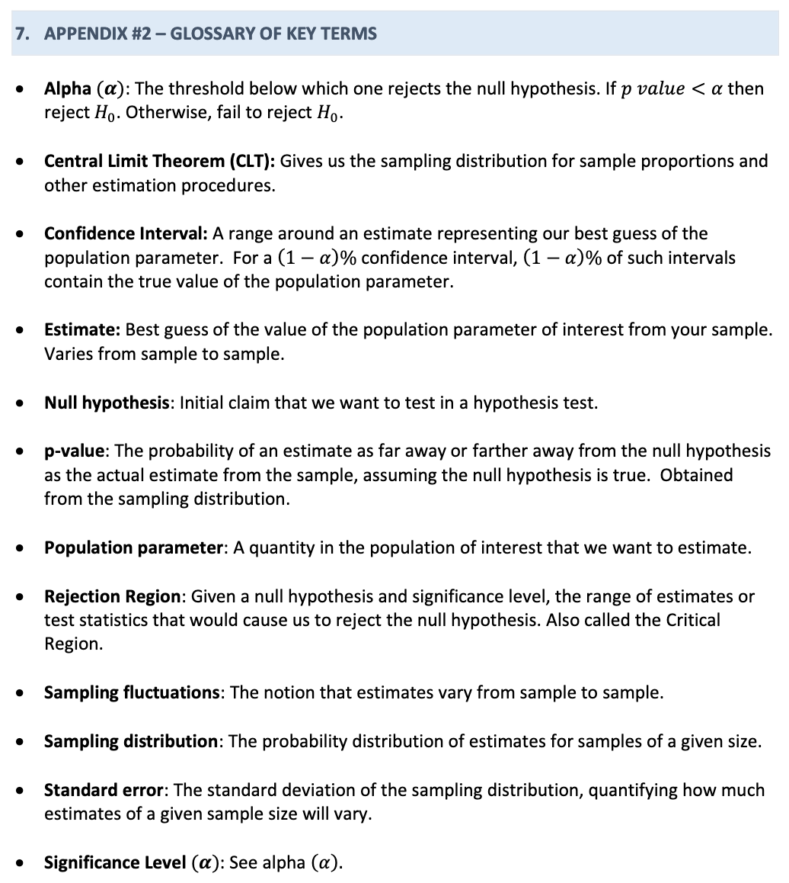

Definitions
Can you explain these definitions to a rubber duck?
Handout #16

Slide 6
Definitions
Other key terms to add to this list:
Beta
Power
Type I / II errors
Practical significance
Systematic error
Non-response bias
Reporting bias
Cherry-picking
Regression to the mean
Underpowered study
etc. !
Can you explain these definitions to a rubber duck?
Handout #16

Slide 7
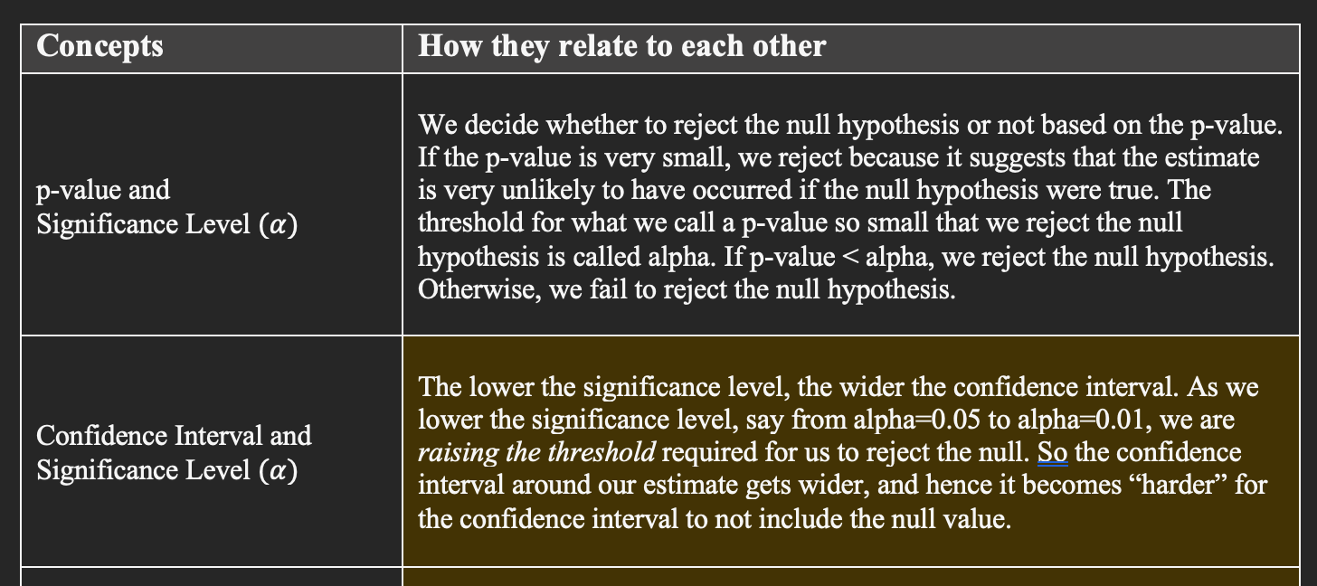
2. Relationships between concepts
PSet 6, Q1.2

Slide 8
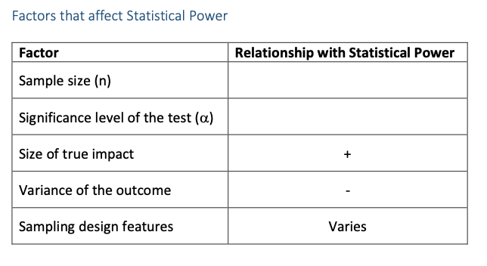
2. Relationships between concepts
Handout #17

Slide 9
2. Relationships between concepts
This often shows up in the exam as a TRUE/FALSE question (e.g. “Increasing the sample size increases statistical power, all else equal”).
Handout #17

Slide 10
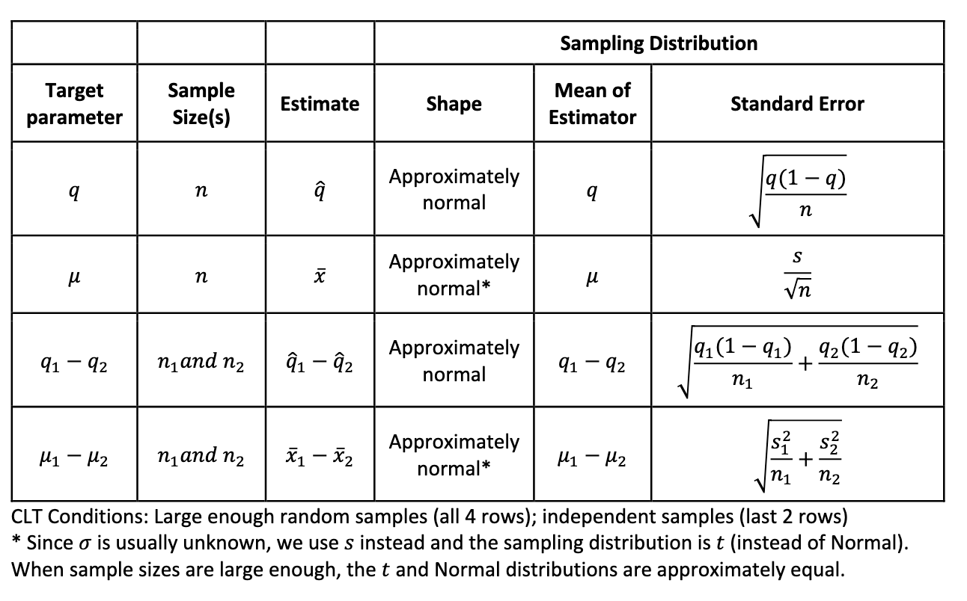
3. Hypothesis testing
Handout #15

Slide 11
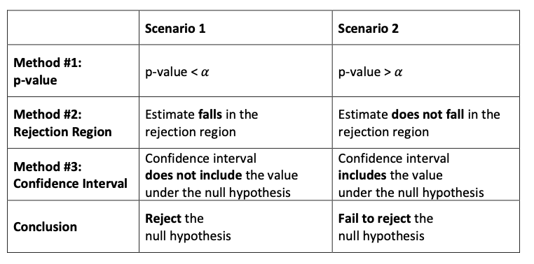
3. Hypothesis testing
Handout #16

Slide 12
Preparation: where to start?
I would strongly recommend that you start by shoring up your foundations:
Definitions (Glossary in Handout 16 + ...)
Relationships between concepts (PSet 6, Q1.2 + ...)
Hypothesis testing (Handout #15, Summary table + ...)

Slide 13
Preparation: where to start?
I would strongly recommend that you start by shoring up your foundations:
Definitions (Glossary in Handout 16 + ...)
Relationships between concepts (PSet 6, Q1.2 + ...)
Hypothesis testing (Handout #15, Summary table + ...)
Once you are confident with this material, move on to practice problems / past exams.

Slide 14
Common mistakes
❌ “If the data are not Normally distributed then we cannot apply the Central Limit Theorem.”
❌ “If the confidence intervals around two estimates overlap, then the difference is not statistically significant.”
❌ “There is a 95% chance that a 95% confidence interval contains the true value.”

Slide 15
Common mistakes
❌ “If the data are not Normally distributed then we cannot apply the Central Limit Theorem.”
❌ “If the confidence intervals around two estimates overlap, then the difference is not statistically significant.”
❌ “There is a 95% chance that a 95% confidence interval contains the true value.”

Slide 16
Common mistakes
❌ “If the data are not Normally distributed then we cannot apply the Central Limit Theorem.”
❌ “If the confidence intervals around two estimates overlap, then the difference is not statistically significant.”
❌ “There is a 95% chance that a 95% confidence interval contains the true value.”

Slide 17
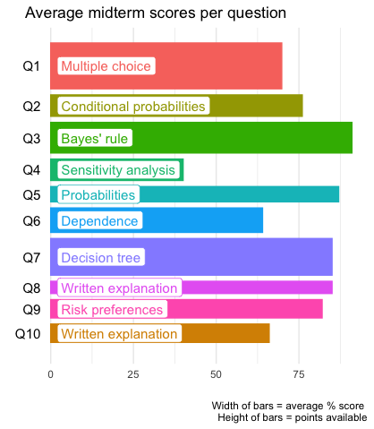
Exam strategy
Looking back on the midterm:

Slide 18
Exam strategy
Looking back on the midterm:
The average score on the multiple choice questions was only 70%...
These questions should be relatively straightforward, but there’s no partial credit.
So: pay attention!

Slide 19
Exam strategy
Looking back on the midterm:
Yes, the sensitivity analysis question was tricky!
Don’t be discouraged if you get stumped - it’s OK to cut your losses and move on.

Slide 20
Exam strategy
Looking back on the midterm:
Many of you struggled on this question (about the MPs voting on a bill) because you failed to recognize it was about dependence.
This was very similar to a PSet question - try to step back and identify the topics in each question.

Slide 21
Exam strategy
Looking back on the midterm:
Average scores were even lower on the open-ended question discussing the quote about nuclear strategy.
Don’t neglect the “wordy” questions!

Slide 22
Exam tips
Read through the entire exam before starting
Why?
Your subconscious brain will start whirring away
Gives you an “easy task” to complete → prevents panic!
Reduces the chance of misreading a question
If you know the points available for each question, you can manage your time better

Slide 23
Exam tips
Read through the entire exam before starting
Why?
Your subconscious brain will start whirring away
Gives you an “easy task” to complete → prevents panic!
Reduces the chance of misreading a question
If you know the points available for each question, you can manage your time better

Slide 24
PSA from Wally

Slide 25
During this busy time, remember to:

Slide 26

During this busy time, remember to:
Get some fresh air

Slide 27
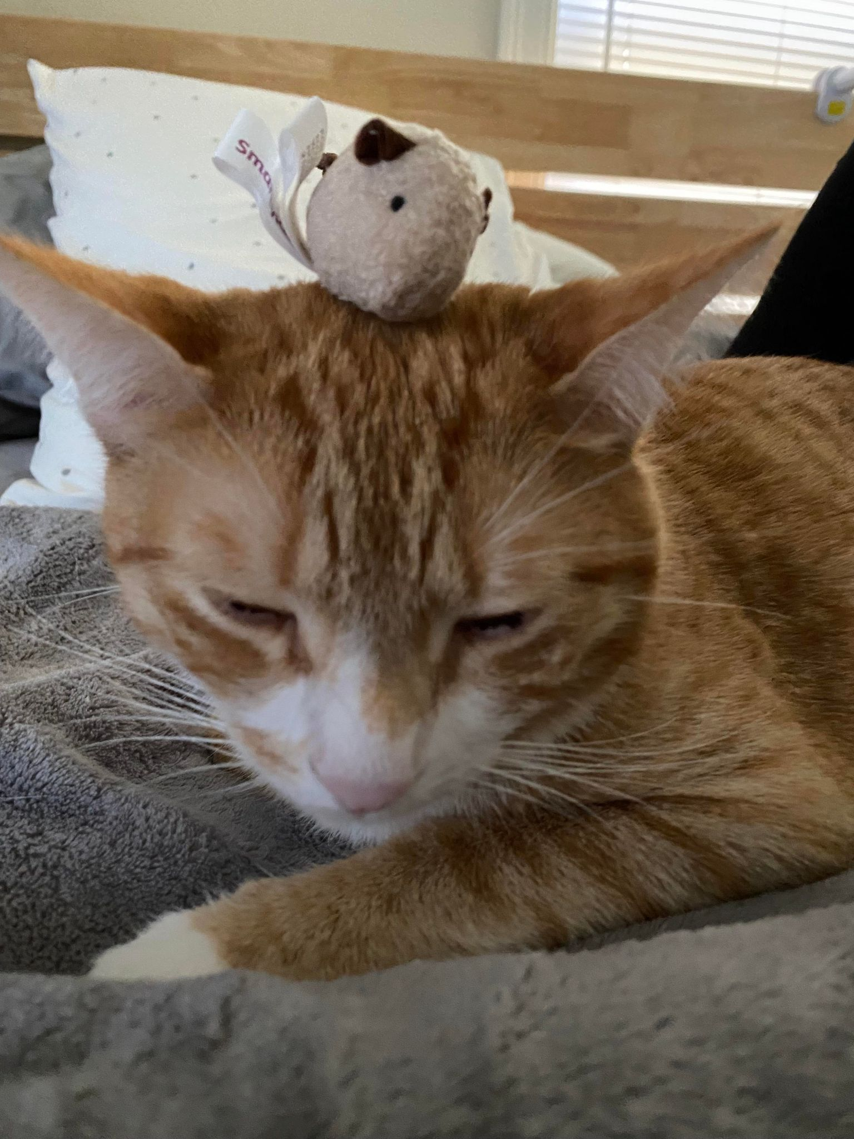
During this busy time, remember to:
Get some fresh air
Hang out with friends

Slide 28
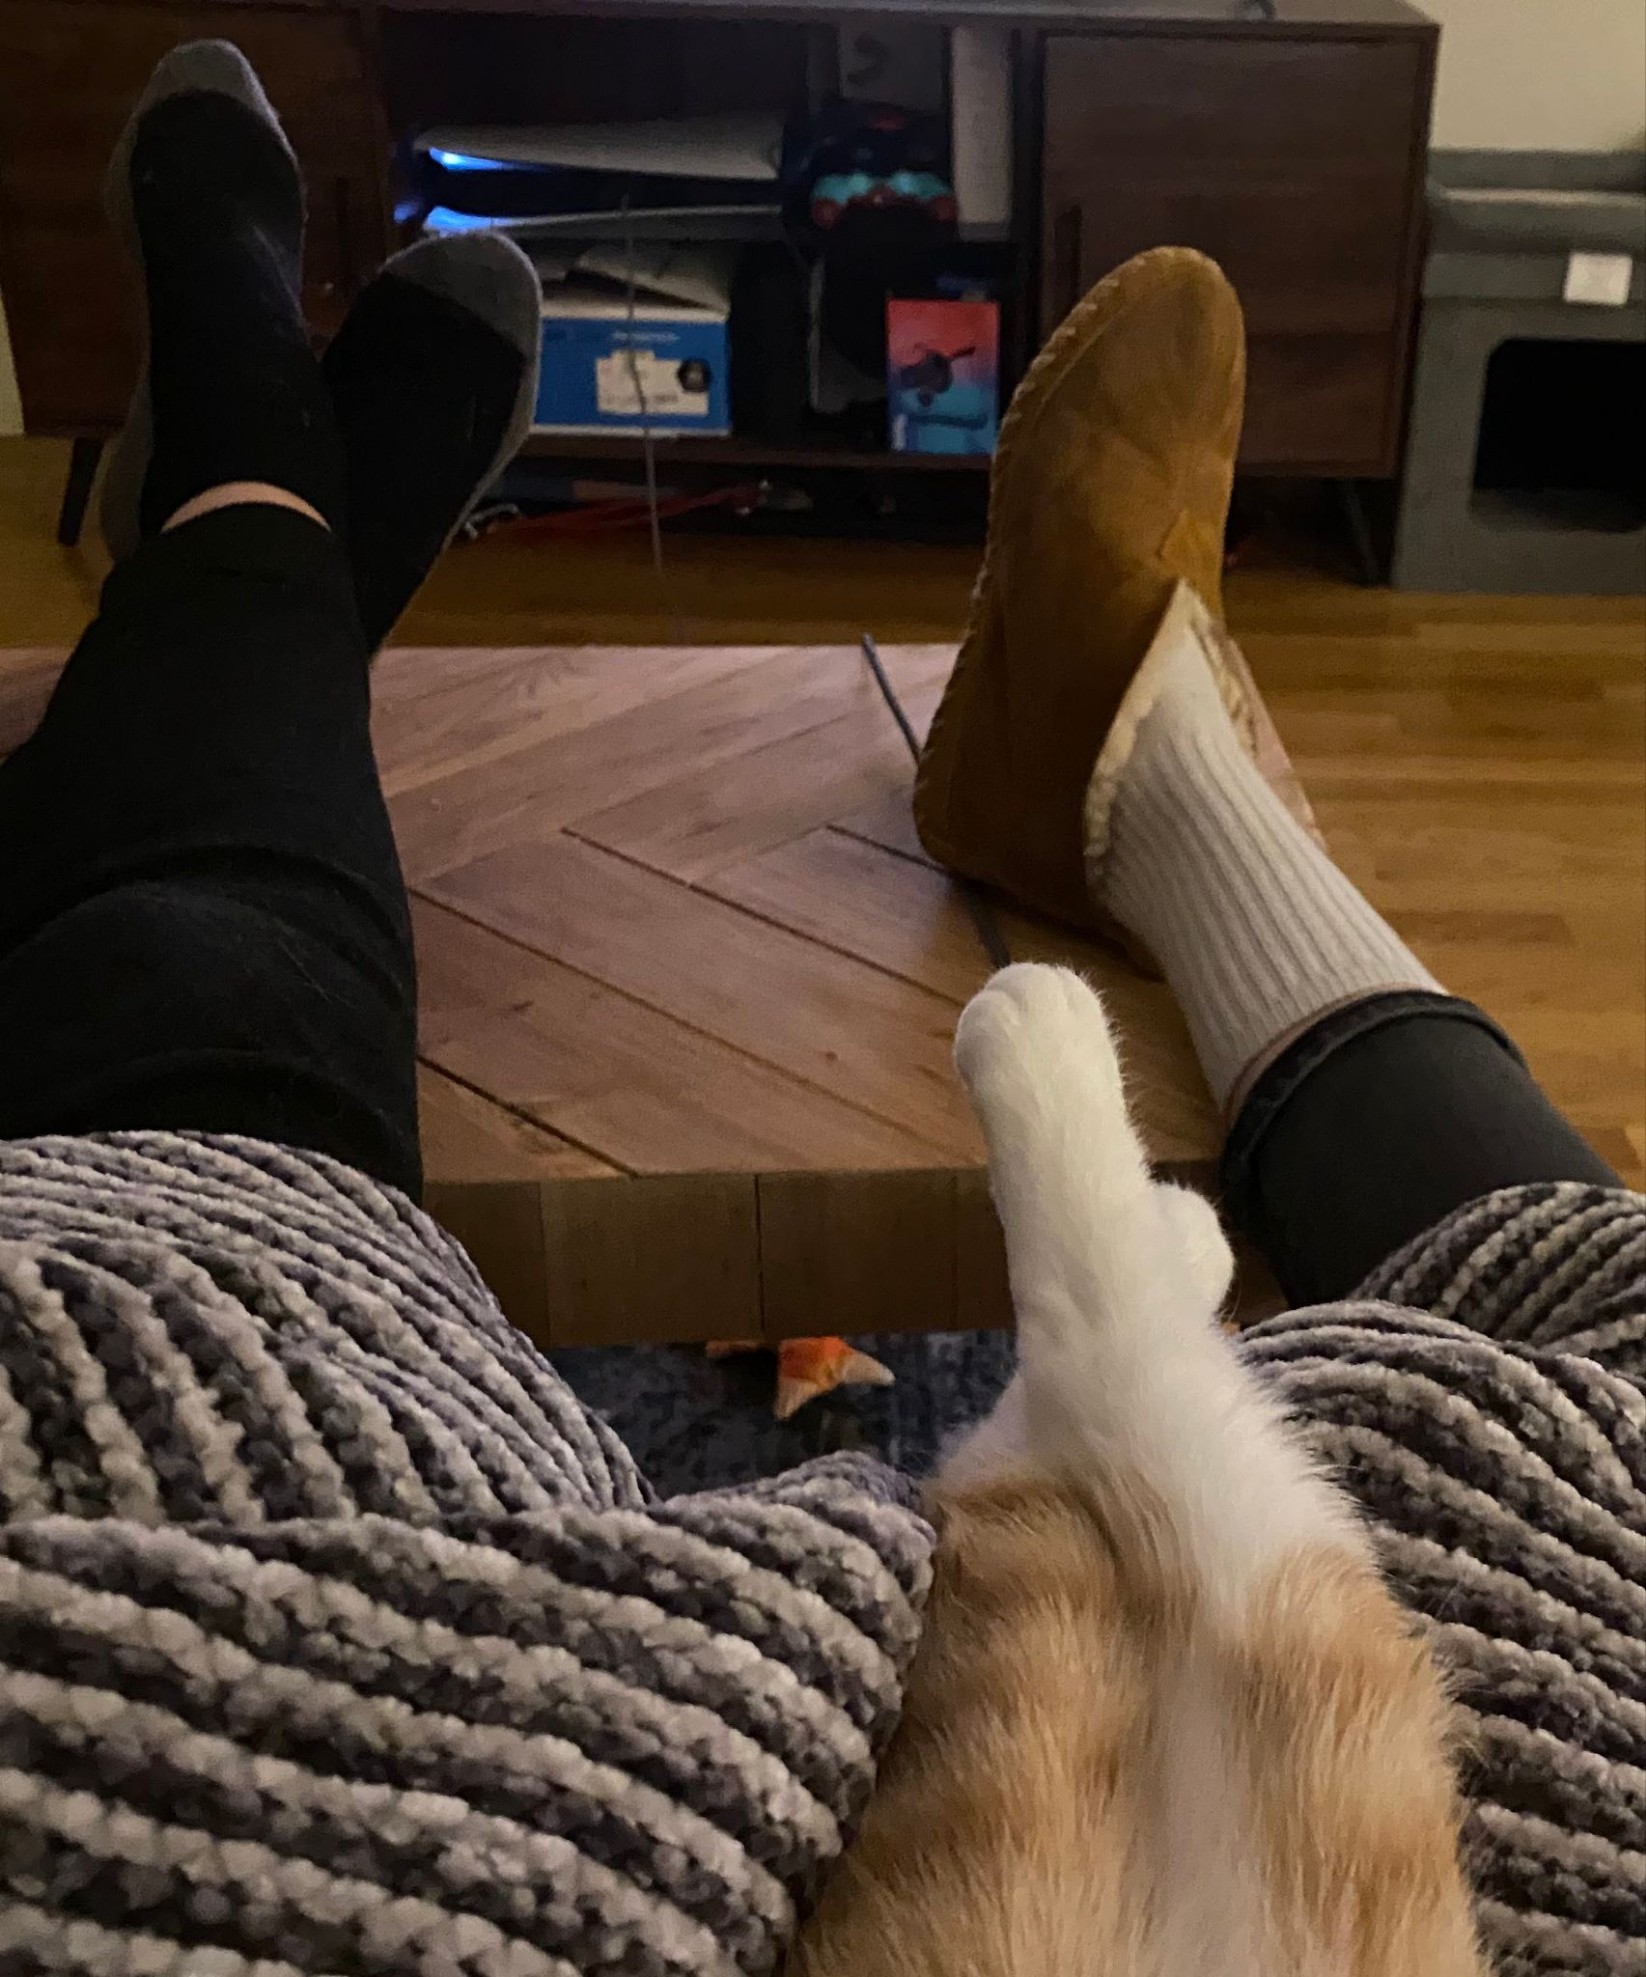
During this busy time, remember to:
Get some fresh air
Hang out with friends
Put your feet up!

